Slide 1

STRESS TESTING
EXAMPLES
-P Rama Lakshmi

Slide 2
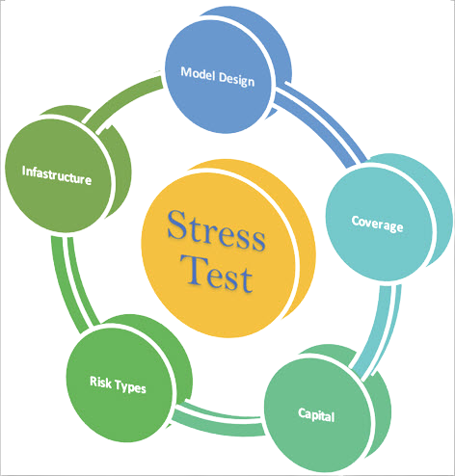
STRESS TESTING
Stress Testing is a type of software testing that verifies stability & reliability of software application.
The goal of Stress testing is measuring software on its robustness and error handling capabilities under extremely heavy load conditions and ensuring that software doesn’t crash under crunch situations.

Slide 3
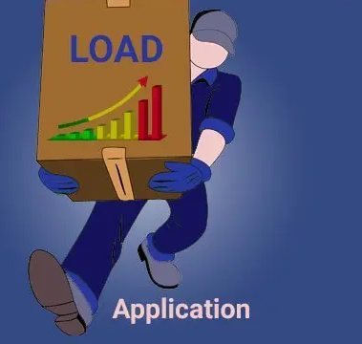
Why yo use Stress Testing ..?
To check whether the system works under abnormal conditions.
Displaying appropriate error message when the system is under stress.
System failure under extreme conditions could result in enormous revenue loss
It is better to be prepared for extreme conditions by executing Stress Testing.

Slide 4

Examples Of Stress Testing
E-commerce website/ application
News website at the time of some major/viral event
Education Board's result website
Financial apps or websites
Web or emailing apps need to be stress tested.
Social networking websites or apps, blogs etc.,

Slide 5
E-Commerce Application
An extremely large no. of visitors hitting the application is simulated using a stress testing tool
The no.of visitors being simulated would be exponentially higher compared to the average no.of visitors expected to visit the website on a day to day basis
The number of users are increased suddenly to the point of failure, until the website crashes and is not longer able to handle additional traffic.
Additional points that are noted are – How the website behaves at this time and if it recovers gracefully
The results of the tests are used to identify bottlenecks, performance improvement areas, recovery / failover mechanisms etc.

Slide 6

Continued…!!!
Commercial shopping apps or websites need to perform stress testing as the load becomes very high
Financial apps or websites need to perform stress test as the load increases at times like when a company share goes up

Slide 7


